Slide 1




Rascal: Rendezvous and Proximity Operations
Team Bravo
SRR Presentation
November 12, 2013

Slide 2
Mission Summary
The proposed mission will demonstrate proximity operations and rendezvous within a 6U spacecraft architecture by:
Stationkeeping: Maintain a 10-75 m relative displacement between a target and chase vehicle for at least 5 orbits.
“Escape” Maneuver: Perform an orbital maneuver that intentionally increases the final relative displacement between the target and chase vehicle to at least 100 meters in a maximum time of 1 orbit.
Rendezvous: Perform an orbital maneuver that intentionally decreases the final relative displacement between the target and chase vehicles to within 50 m for a period of time of at least 5 orbits.

Slide 3



Configuration Options
Full 6U satellite
Active – Passive
Active - Active

Slide 4
Configuration Option: 6U
Pros
More power available
No separation required
Cons
SSRL does not have the capabilities to identify and track resident space objects
LSP may not allow rendezvous with resident space object
More delta-v required for operations
Eliminated

Slide 5
Configuration Option: Active - Passive
Pros
Less Complex
Target vehicle accompanies chase vehicle to orbit
Cons
No control over vehicle
Harder to maintain relative velocities
Less redundancy
Eliminated

Slide 6
Configuration Option: Active - Active
Pros
Redundancy
Target vehicle accompanies chase vehicle to orbit
Replicable
Active control over target vehicle
Cons
Increased mission complexity
More expensive
Selected

Slide 7
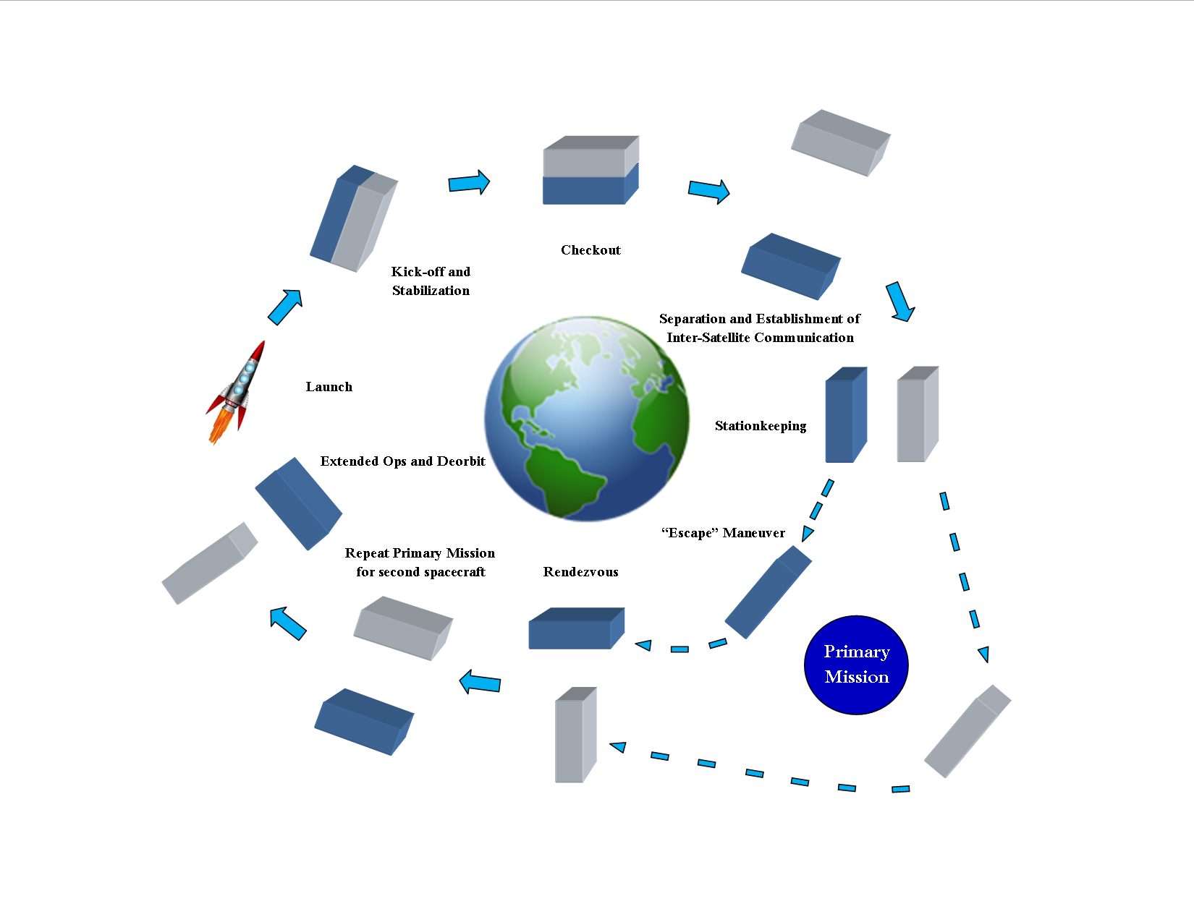
Concept of Operations

Slide 8
RCL.PL.STR1

Slide 9
RCL.PL.STR2

Slide 10
RCL.PL.STR3

Slide 11
RCL.PL.STR4

Slide 12
RCL.PL.MOP1

Slide 13
RCL.PL.MOP2

Slide 14
RCL.PL.STR5

Slide 15
RCL.PL.STR6

Slide 16
RCL.PL.STR7

Slide 17
RCL.PL.STR8

Slide 18
RCL.PL.STR9

Slide 19
RCL.PL.STR10

Slide 20
RCL.PL.STR11

Slide 21
RCL.PL.STR12

Slide 22
RCL.PL.STR13

Slide 23
RCL.PL.STR14

Slide 24
RCL.PL.STR15

Slide 25
RCL.PL.STR16

Slide 26
RCL.PL.STR17

Slide 27
RCL.PL.STR18

Slide 28
RCL.PL.PLD1

Slide 29
RCL.PL.PLD2

Slide 30
RCL.PL.STR19

Slide 31
RCL.PL.PRP1

Slide 32
RCL.PL.THM1

Slide 33
RCL.PL.PRP2

Slide 34
RCL.PL.PRP3

Slide 35
RCL.PL.PRP4

Slide 36
RCL.PL.TST1

Slide 37
RCL.PL.TST2

Slide 38
RCL.PL.TST3

Slide 39
RCL.PL.TST4

Slide 40
RCL.PL.TST5

Slide 41
RCL.PLE.MOP1

Slide 42
RCL.PLE.MOP2

Slide 43
RCL.PLE.MOP3

Slide 44
RCL.PLE.MOP4

Slide 45
RCL.SS.MOP1

Slide 46
RCL.SS.MOP2

Slide 47
RCL.SS.MOP3

Slide 48
RCL.SK.MOP1

Slide 49
RCL.ESC.MOP1

Slide 50
RCL.RDZ.MOP1

Slide 51
Conclusion

Slide 52

Questions?

